Slide 1
Bond Oversight Committee Meeting
Fourth Quarter 2016
Jan. 31, 2017
Notes:
Welcome – Derrick Sanders

Slide 2
Fourth Quarter Progress
Projects completed in 2016:
7 schools
2 athletic facilities
2 major campus renovations
5 construction contracts approved in 2016 Q4
7 projects scheduled for completion in 2017 Q1, Q2:
Six schools
1 athletic complex
Completed Projects
Sterling Aviation HS
North Houston ECHS
South ECHS
Worthing HS Phase 1
Condit ES
Mark White ES
Mandarin IMS
Fonwood ECC (non bond)
Tanglewood MS
Butler & Barnet Stadiums
Notes:
Fourth Quarter Progress – Derrick Sanders

Slide 3
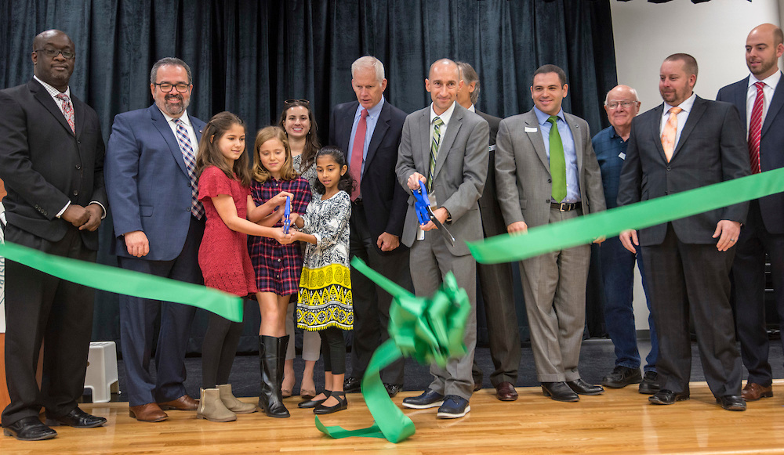
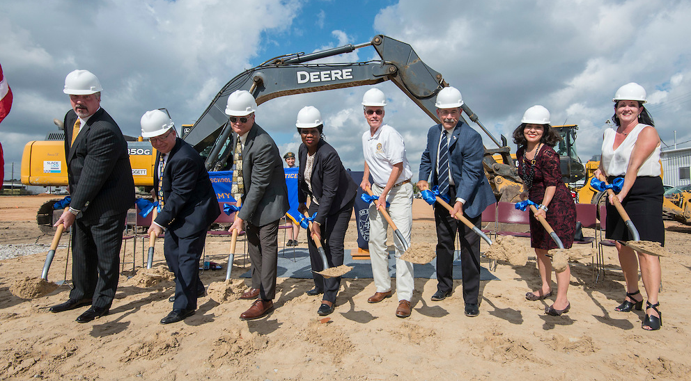
Fourth Quarter Progress
Grand Openings held for South Early College High School, Mandarin Immersion Magnet School, and Mark White and Condit elementary schools
Groundbreakings held for Eastwood Academy, High School for Law & Justice, Wilson Montessori and (non-bond) Energy Institute HS
Condit ES Grand Opening
HSLJ Groundbreaking
Notes:
Fourth Quarter Progress – Derrick Sanders

Slide 4
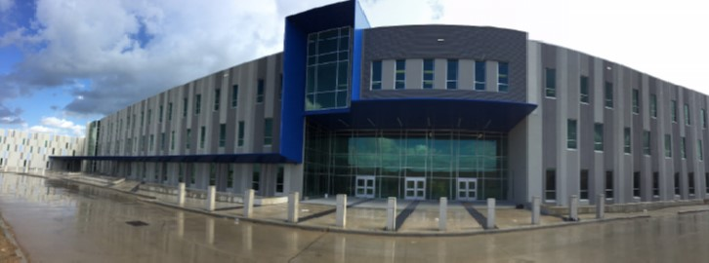
Project Highlights – Now Open
Sterling Aviation High School
Sterling Aviation High School
Opened January 2017
First comprehensive high school built under 2012 bond, and first built in HISD in 16 years
Notes:
Project Highlights – Derrick Sanders

Slide 5
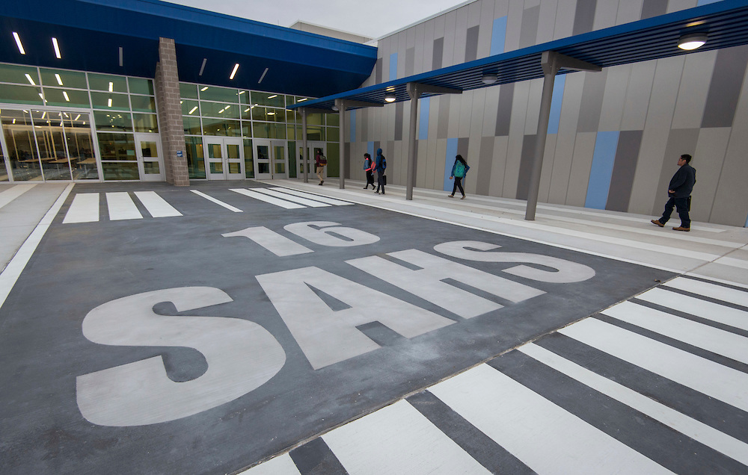
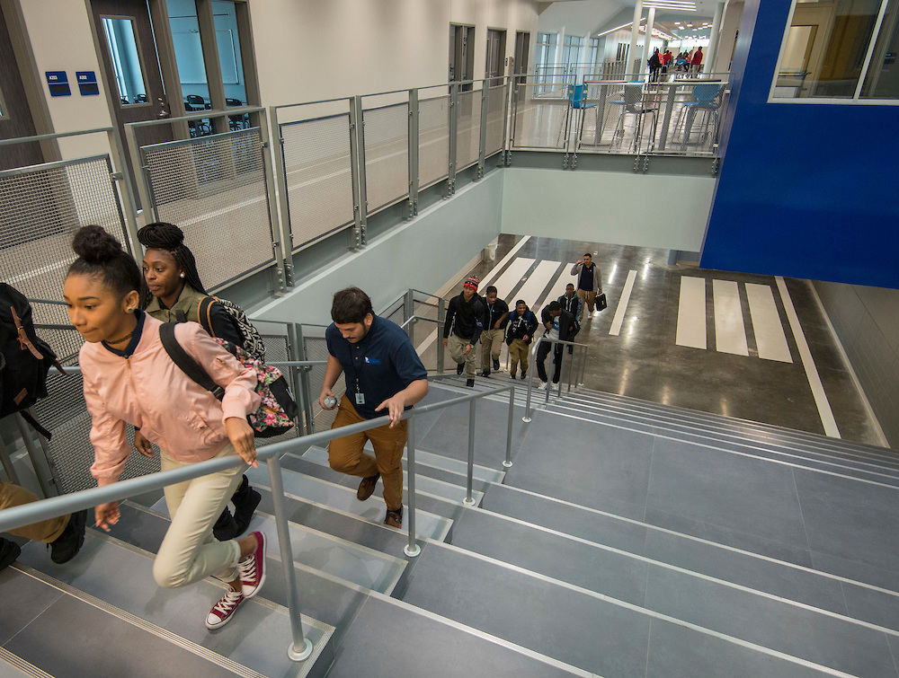
Project Highlights – Now Open
Sterling Aviation High School
Sterling Aviation High School
Sterling Aviation High School
New School for 1,600 to 1,800 students.
Punch list ongoing. Old building soon to be demolished to make way for parking lot and athletic fields.
Notes:
Project Highlights – Derrick Sanders

Slide 6
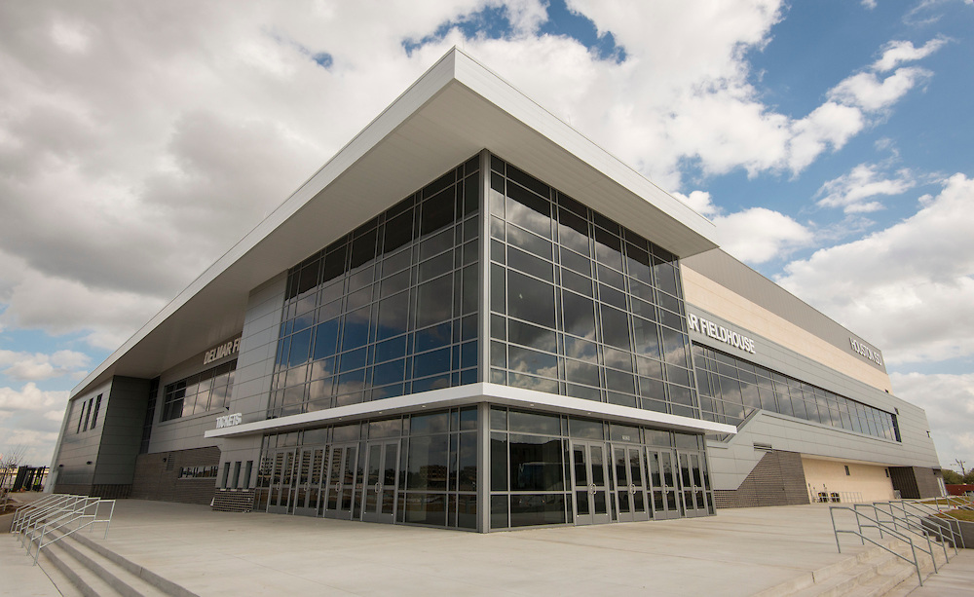
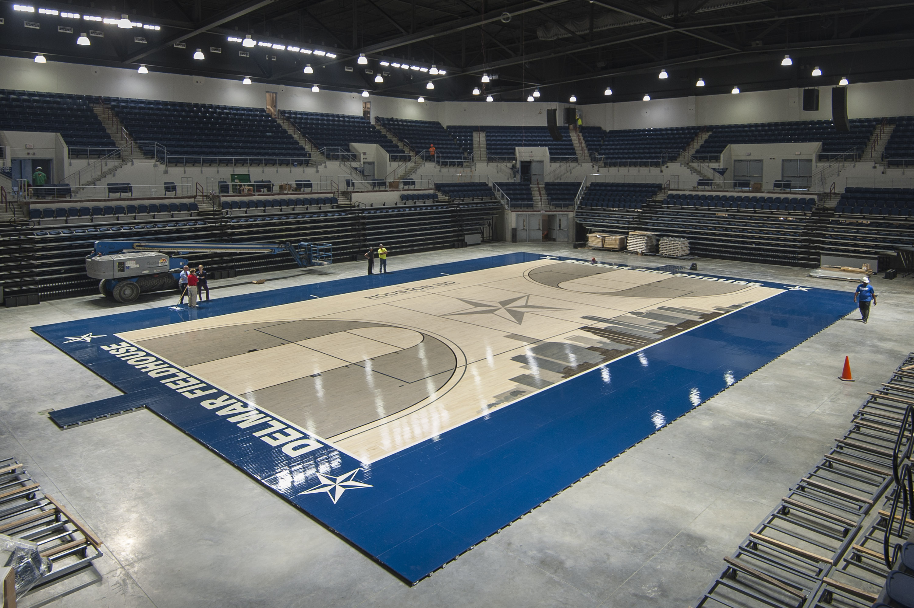
Project Highlights – Open Soon
Delmar Fieldhouse
Delmar Fieldhouse
Delmar Fieldhouse
Grand Opening Celebration: 10 a.m. on Thursday, Feb. 10
Punchlist work ongoing
Notes:
Project Highlights – Derrick Sanders

Slide 7
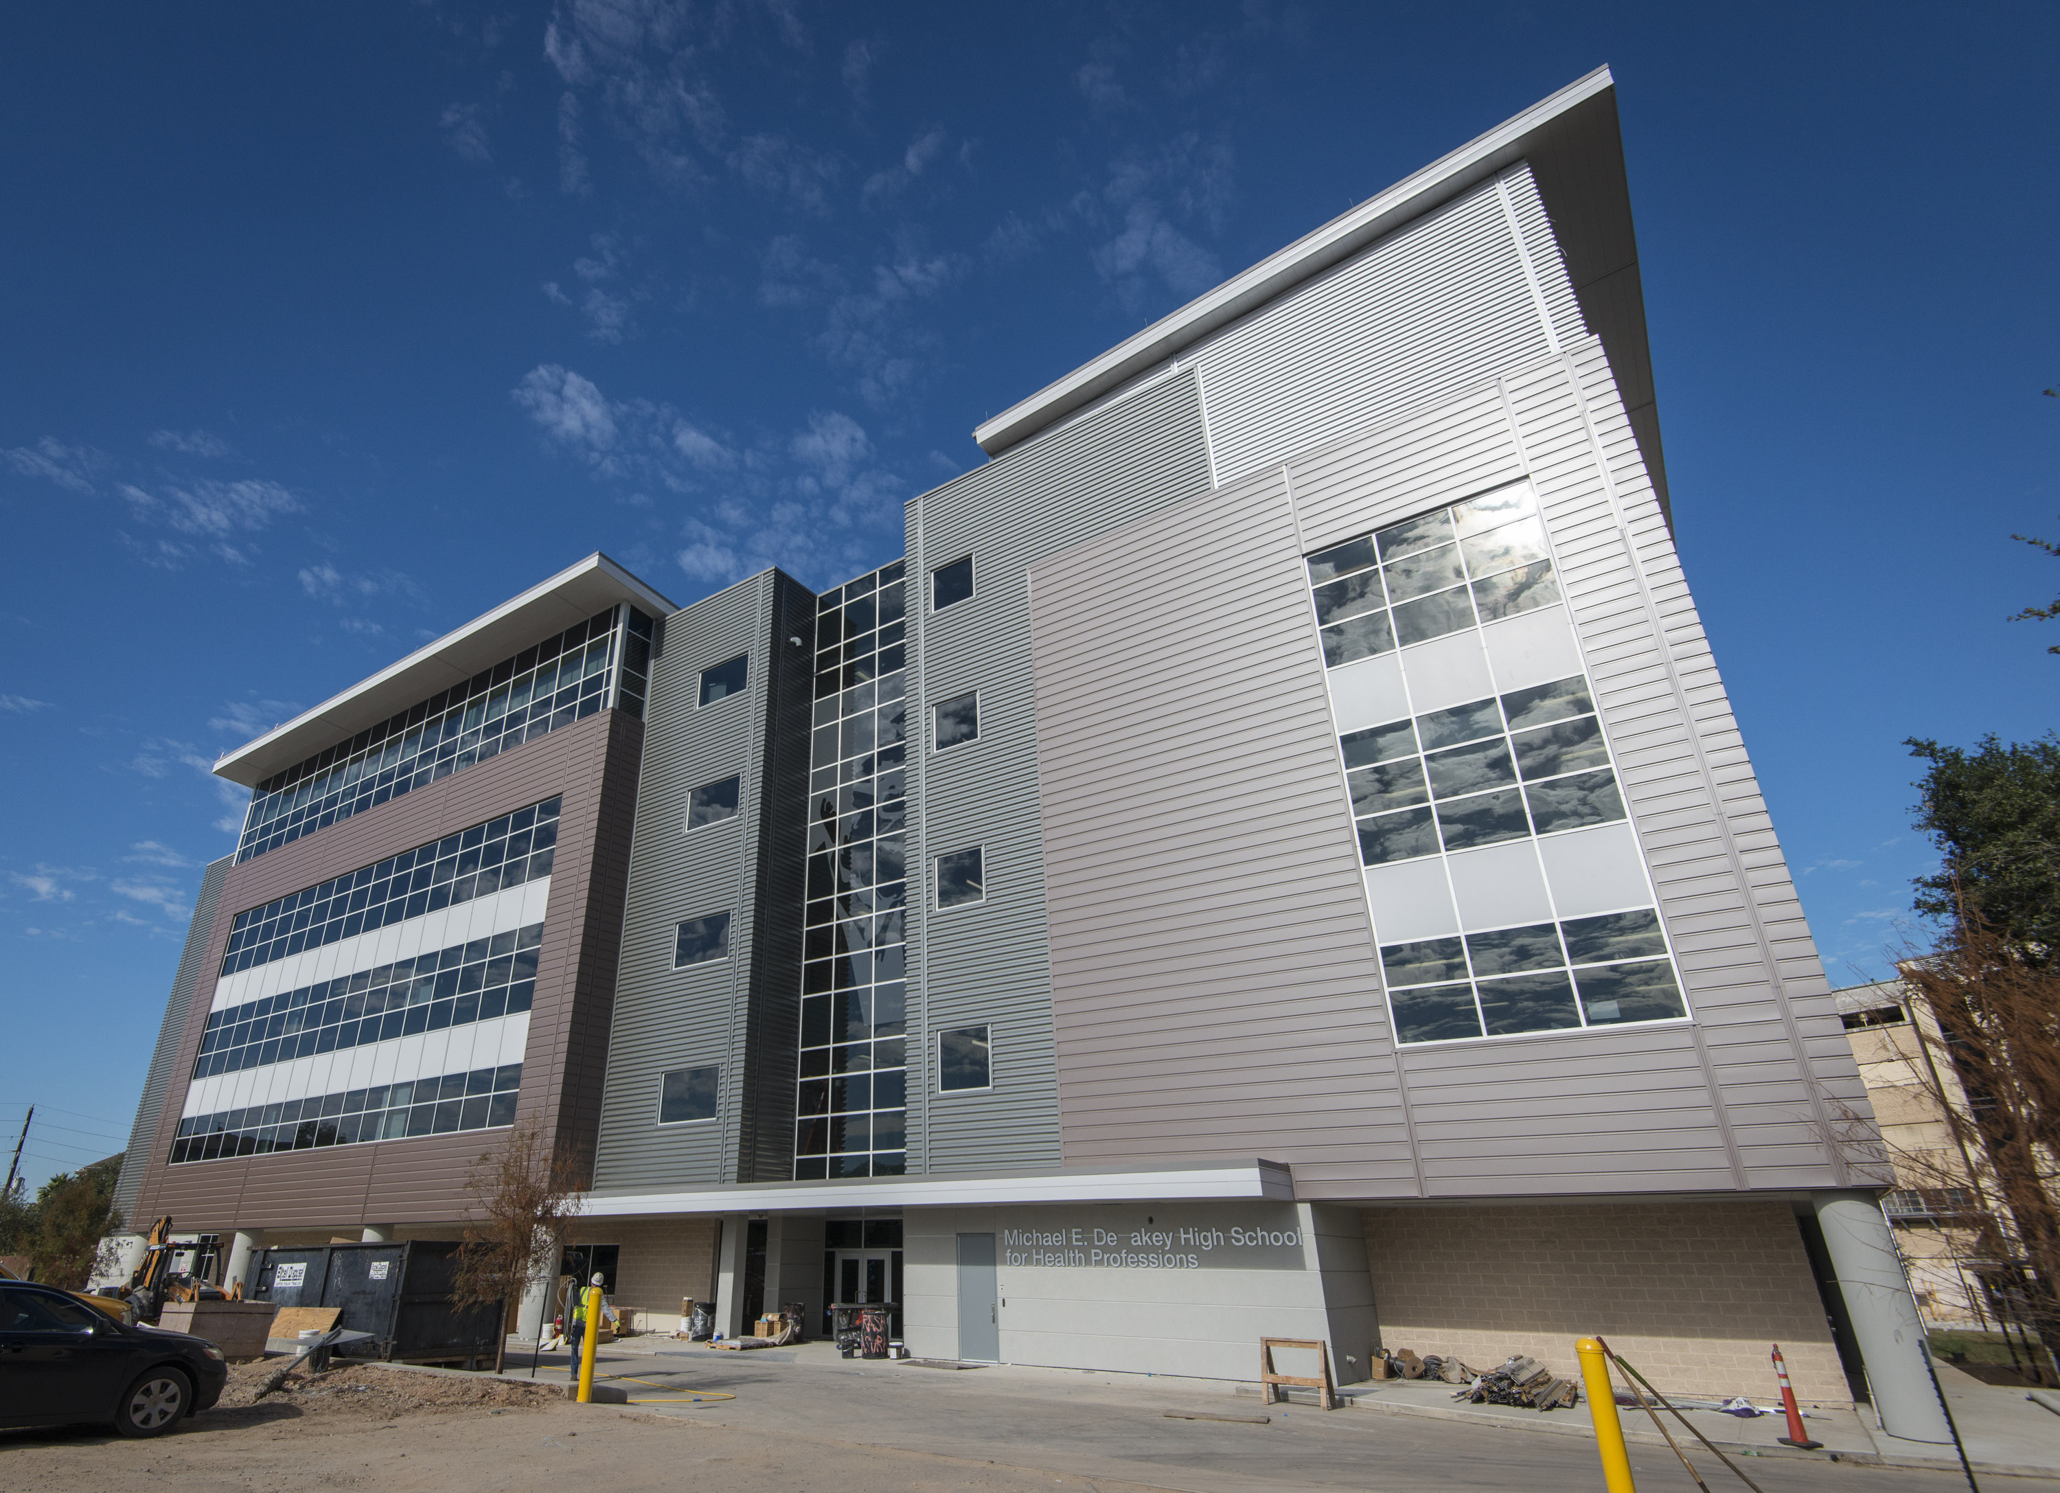
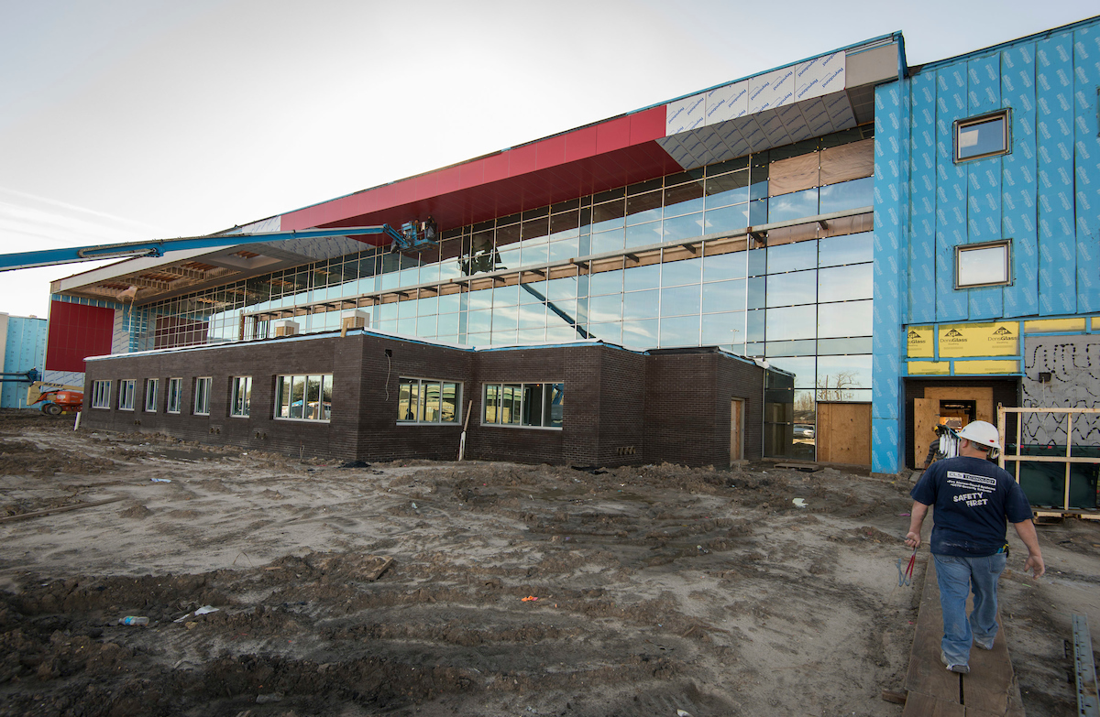
Project Highlights – Open Soon
DeBakey HSHP
Furr HS
DeBakey HSHP
Furr HS
New school, 900 to 1,000 students
Spring completion
New school, 1,000 to 1,300 students
Summer completion
Notes:
Project Highlights – Derrick Sanders

Slide 8
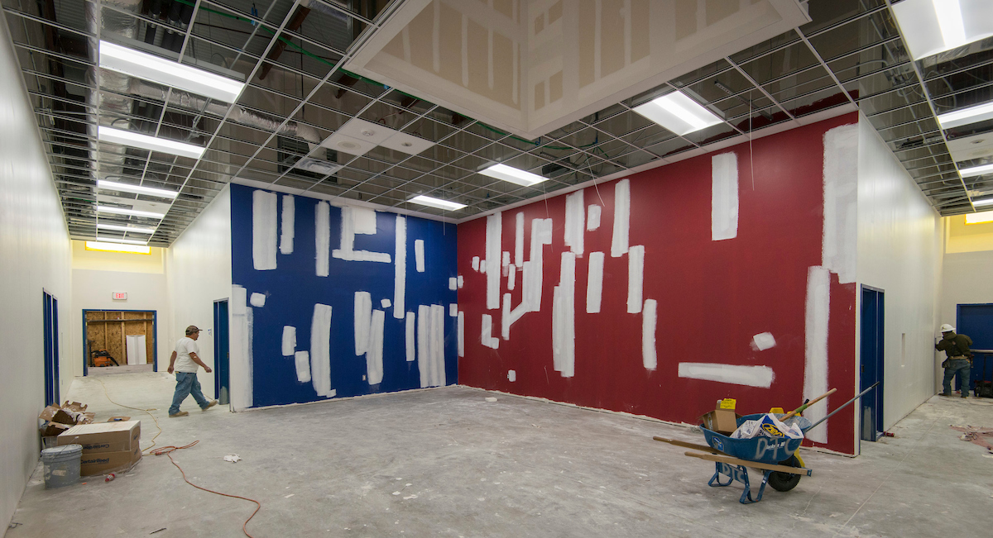
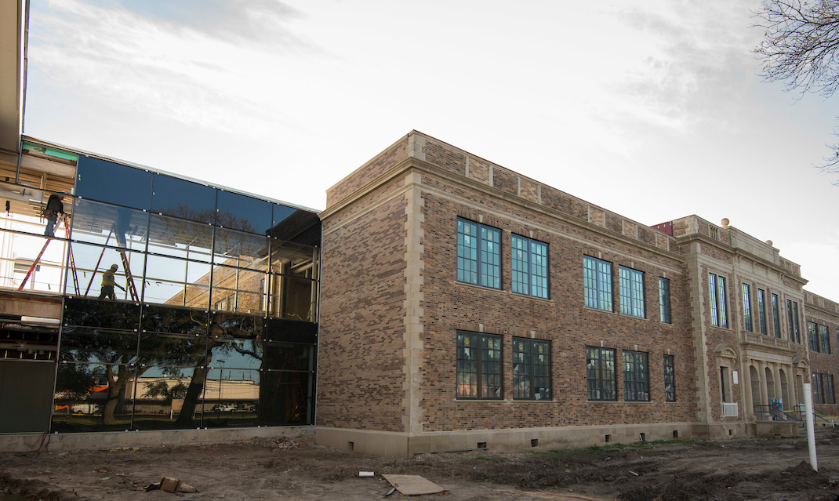
Project Highlights – Open Soon
Sharpstown Int’l School
Milby HS
Sharpstown International School
Milby HS
Renovations and security upgrades
Summer completion
Renovation and addition, 1,800 to 2,000 students
Summer completion
Notes:
Project Highlights – Derrick Sanders

Slide 9
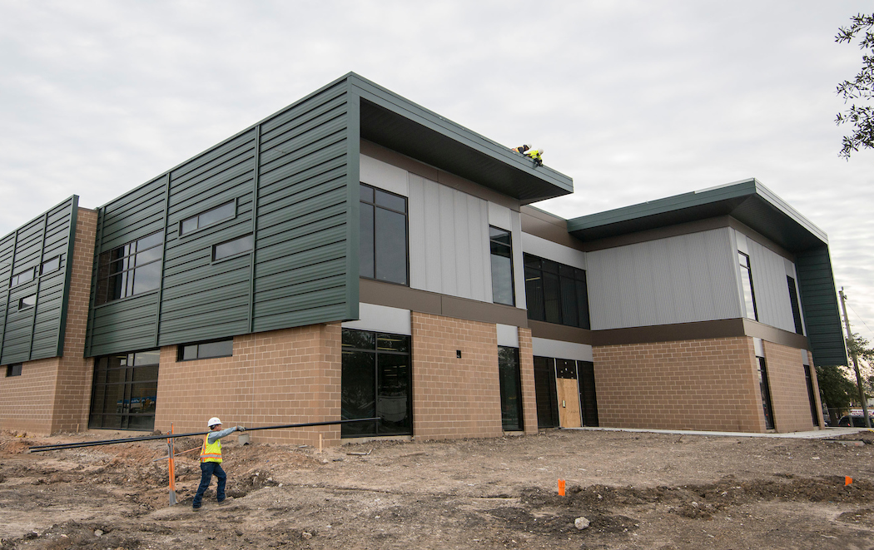
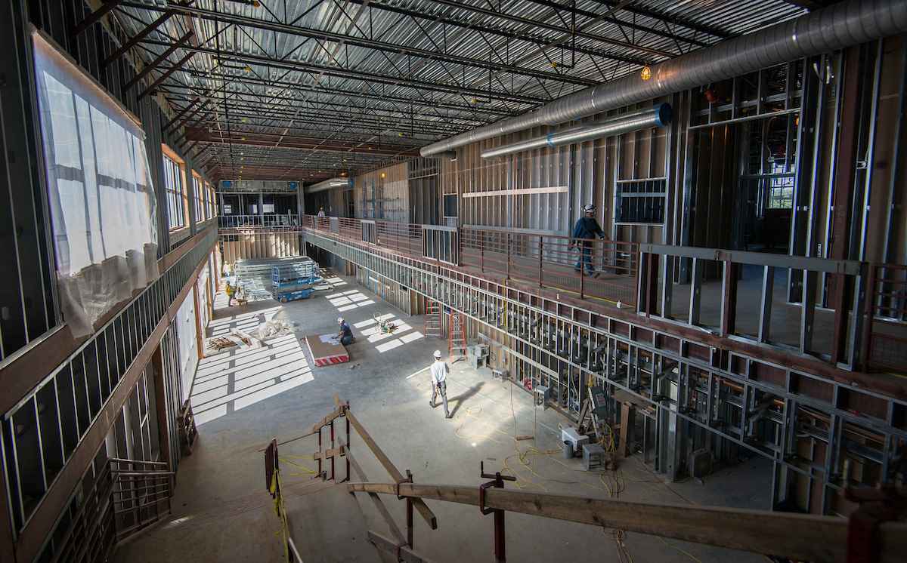
Project Highlights – Open Soon
Wisdom HS
Mickey Leland CPA
Wisdom HS
Mickey Leland College Prep Academy
New school, 1,700 to 1,900 students
Summer completion
New boys school, 900 to 1,000 students
Summer completion
Notes:
Project Highlights – Derrick Sanders

Slide 10
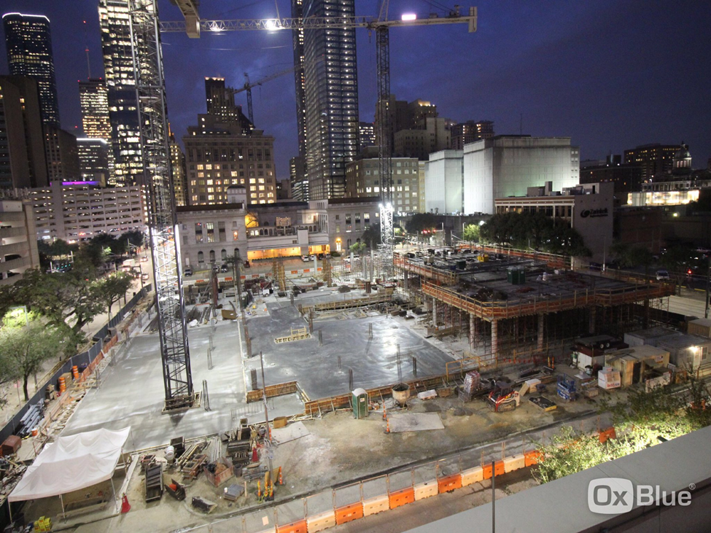
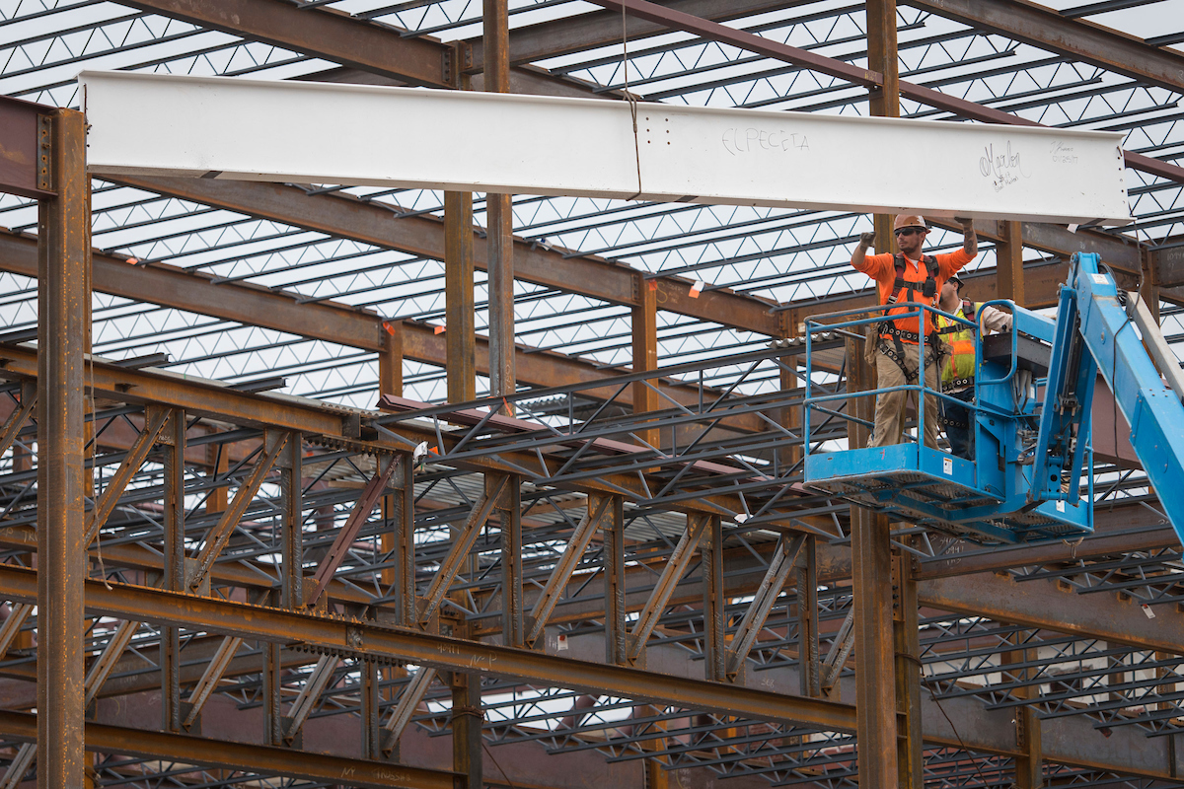
Construction Highlights
HSPVA
YWCPA
HSPVA
Young Women’s College Prep Academy
New performing and visual arts school for 750 students
Renovation and addition to school for 1,000 students
Notes:
Project Highlights – Derrick Sanders

Slide 11
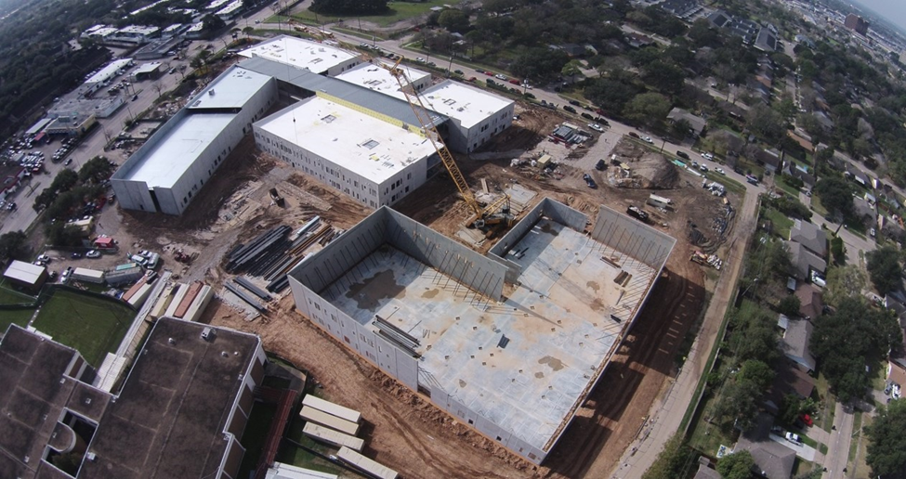
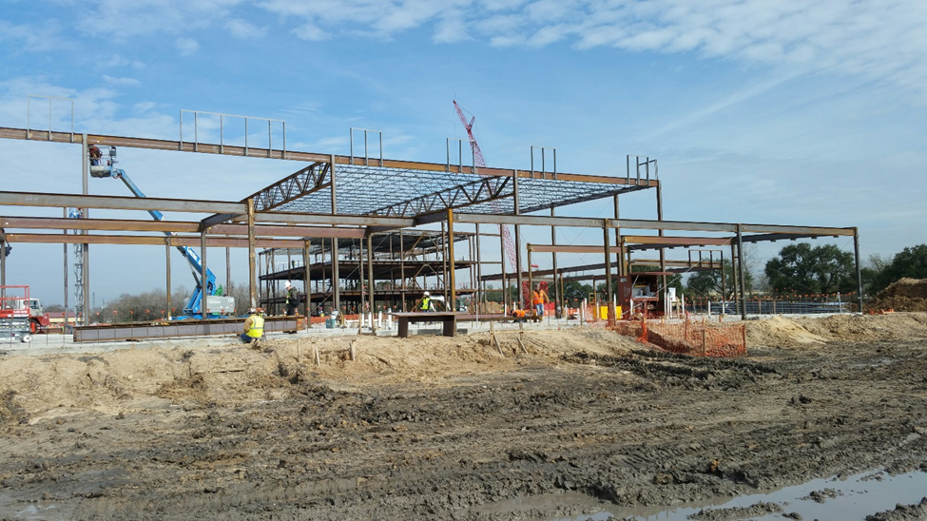
Construction Highlights
Sharpstown HS
Lawson MS
Sharpstown HS
Lawson MS
New school for 1,300 to 1,500 students
New school for 1,300 to 1,500 students
Notes:
Project Highlights – Derrick Sanders

Slide 12
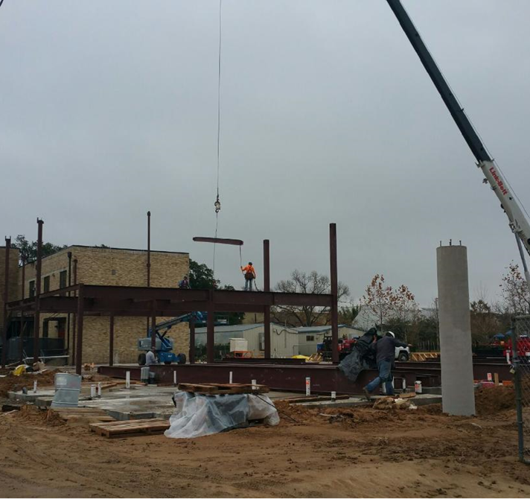
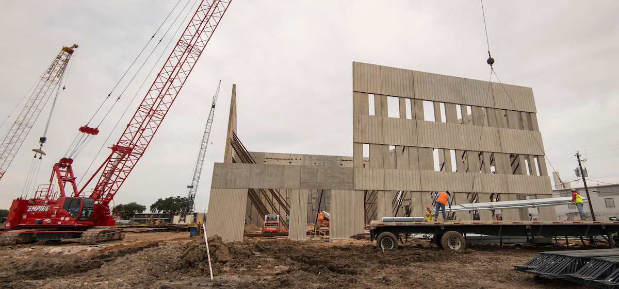
Construction Highlights
Wilson Montessori
HSLJ
Wilson Montessori School
HSLJ
Addition, renovations for 750 to 900 students
New school for 1,300 to 1,500 students
Notes:
Project Highlights – Derrick Sanders

Slide 13
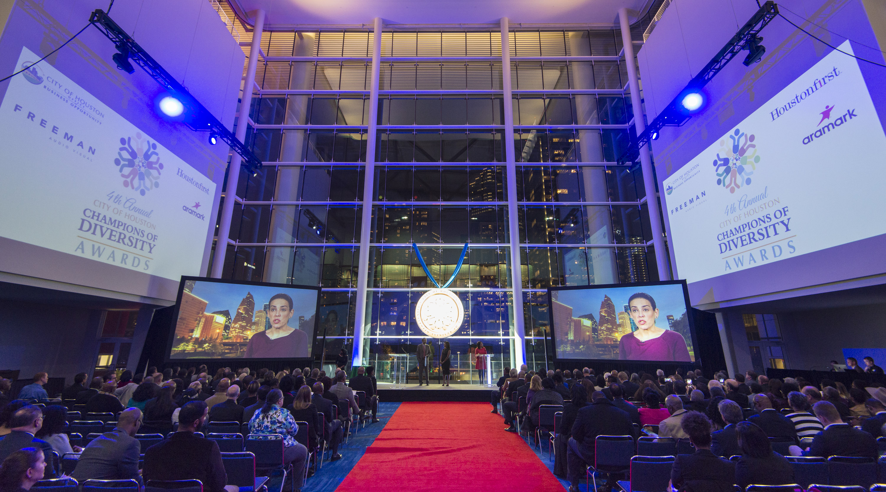
Doing Business
Awarded the City of Houston Community Partner of the Year
M/WBE commitments for contracts awarded to date:
Architect projects represent 53.26%
Construction firm projects represent 22.29%
Program management firm projects represent 46.88%
Other projects represent 40.79%
Notes:
M/WBE – Alexis Licata

Slide 14
M/WBE networking events
Workshop Wednesdays
October Resolving Conflict in the Workplace
December How to Compete on Value and Not Price
Notes:
M/WBE – Alexis Licata

Slide 15
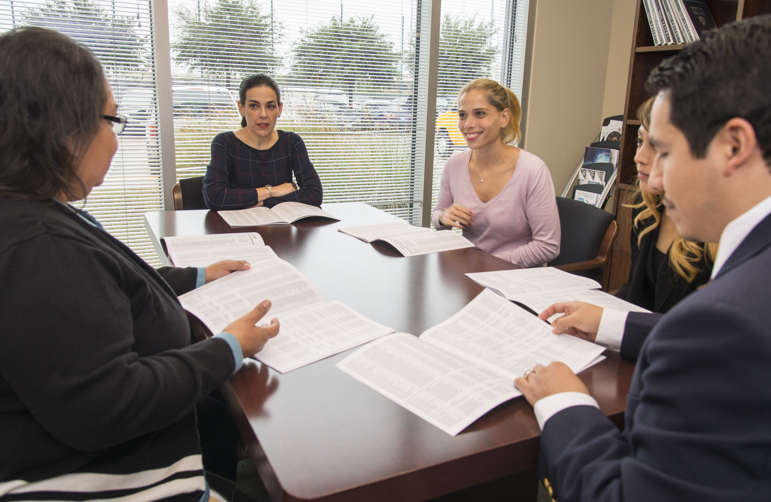
M/WBE outreach events
Houston Minority Supplier Diversity Council: 2016 Business Expo
WBEA: Corporate Advisory Committee
Greater Houston Black Chamber: 2nd Tuesdays with the Chamber
East End Chambers of
Commerce: Business over Breakfast
Hispanic Chamber of Commerce: Networking & Business Development Expo
City of Houston: Meet the Buyer
Notes:
M/WBE – Alexis Licata

Slide 16
M/WBE commitment
Certified Minority/Women Owned Businesses Breakdown
2012 Total Combined Projects
Committed WBE
$40,197,437
4%
Notes:
M/WBE – Alexis Licata

Slide 17
Bond financial report
Original 2012 Bond Program is $1.89 billion, with issuance of bonds planned in four sales. In 2015, Board of Education approved an additional $212.4 million. The total budget now is $2.1 billion.
Commitments of $1,141,433,433 (including encumbrances of $480,923,838 and actual expenditures of $660,509,595) leaving $961,016,530 of available funding.
Total Budget, Commitments & Available Funding to Date Total Budget: $2.1 billion
(issuance sales in millions)
2013
(Sold Feb)
2014
(Sold Sept)
2015
2016
(Sold April)
Notes:
Finance – Sherrie Robinson and Tonya Savoie

Slide 18
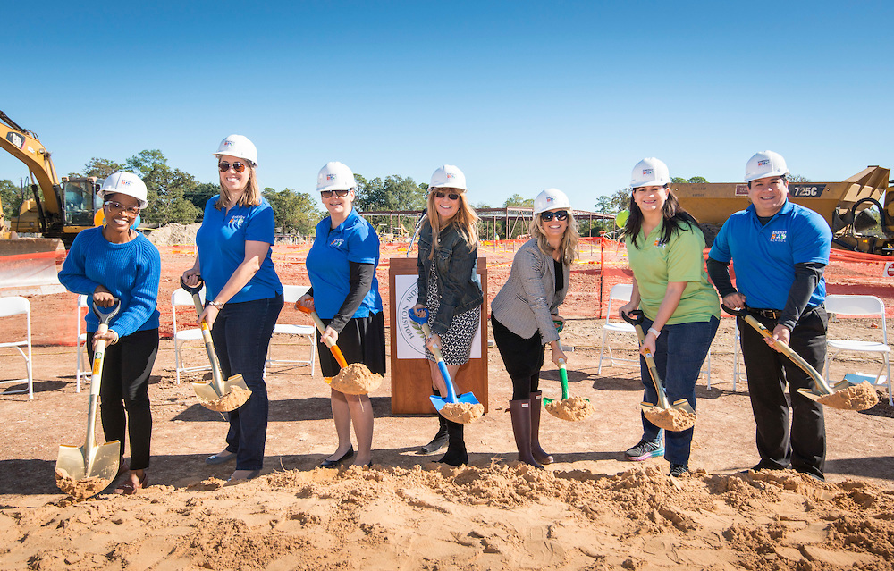
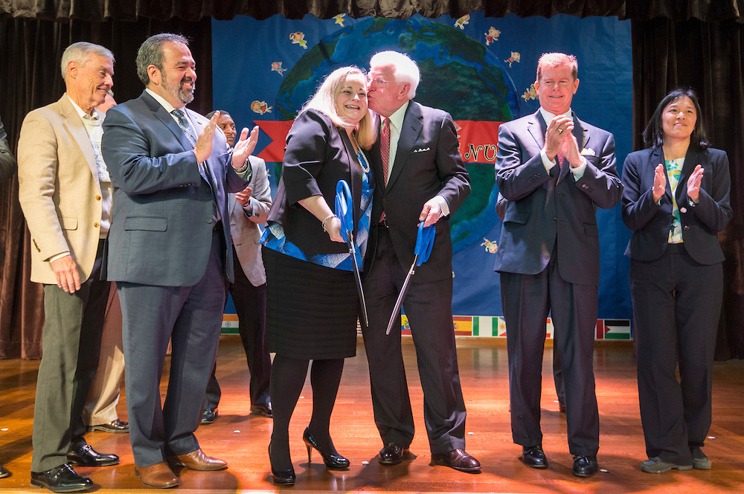
Communications
Coordinated 4 grand openings, 4 groundbreakings in Q4
Coordinating several more milestone celebrations in Q1
Completed stakeholder survey regarding communications & community engagement
Posted regular updates to social media, blog
Strategically pitched stories to media outlets
Energy institute HS Groundbreaking
Mark White ES Grand Opening
Notes:
Communications – Sylvia Wood

Slide 19
Communications
700 responses, mostly parents and staff
Results trend positive – all ratings 5 or higher on 10-point scale
Stakeholders want updated via:
Email
Campus Website
District Website
Notes:
Communications – Sylvia Wood

Slide 20
Looking ahead
Set for completion in 2017 Q1:
DeBakey HSHP completed
Delmar Fieldhouse completed
Waltrip HS
Set for completion in 2017 Q2:
Furr HS
Wisdom HS
Leland College Prep
Sharpstown International
Milby HS (open in time for summer school)
What’s Next?
By end of Q1:
Construction contracts executed on all projects
By end of Q2:
40% of all projects to be completed, open to students
Notes:
Looking Ahead – Derrick Sanders

Slide 21
Thank you

